Slide 1


Influencers of Perioperative Nurse Turnover
Carole G. Mayes, PhD, RN, NPD-BC, CNOR
Clinical Educator II
Rutland Regional Medical Center
Karen R. Cochran, PhD, RN, CNOR
Nursing Faculty
Western Carolina University
October 11, 2025

Slide 2





Objectives
Statistical Trends
Impact of perioperative nurse turnover
Results of initial perioperative nurse turnover study
Dependability of the Perioperative Nurse Turnover Theory
What can you do?

Slide 3

Let’s take a second to reflect

Slide 4










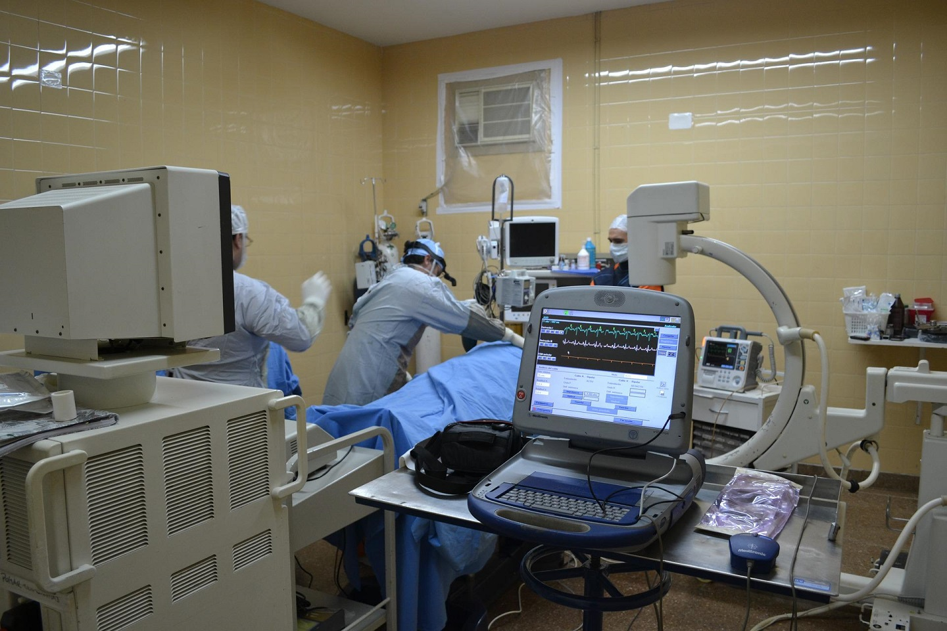


Slide 5

Statistics
Registered Nurse (RN) Statistics
9.6% or 47 vacancies on average for an organization¹
16.4% turnover rate¹
22.3% of newly hired RNs left within 1 year¹
Perioperative Nurse Statistics
13.7% turnover rate¹
62% perioperative managers report at least 1 open position²
99% perioperative managers report having open clinical positions²
40% perioperative leaders reported increased turnover³
30% turnover rate for perioperative nurses in 1st year³
70% perioperative leaders reported increased difficulty recruiting experienced RNs²
27% somewhat likely or very likely to quit in 1 year²
66% thinking of changing employers²
3% might leave for personal reasons²
1% leaving for school²
Notes:
RN vacancy rate: 9.6% or 47 vacancies on average (NSI, 2025)
Nurse turnover is recorded at 16.4%, a 2.0% decrease (NSI, 2025)
Registered Nurses recorded a mean tenure at 5.95 years and ranging to 16.7 years. (NSI, 2025)
RNs: Over twenty-two percent (22.3%) of all newly hired RNs left within a year (NSI, 2025)
Surgical nurse turnover: 13.7% (NSI, 2025)
62% periop managers report at least 1 open position (Bacon)
99% periop managers report having open clinical positions (Bacon)
61.4% exited employees had less than 2 years of service (NSI, 2025)
Employees with 5+ service have greater organizational commitment (NSI, 2025)
40% OR leaders reported increased turnover (Sadler, 2024)
1st year turnover for OR nurses approximately 30% (Sadler, 2024)
70% periop leaders reported increased difficulty recruiting experienced nurses
27% somewhat likely or very likely to quit in 1 year (Bacon)
66% thinking of changing employers (Bacon)
10% planning to retire (Bacon)
3% might leave for personal reasons (Bacon)
1% leaving for school (Bacon)
Every RN hired saves $79,100. An NSI contract to replace 20 travel nurses could save your institution $1,582,000 (NSI, 2025)
RN turnover has been decreasing from 27.1 to 16.4 from 2021 to 2025 (NSI, 2025)
To better understand how hospitals met their RN staffing needs, respondents were asked to identify strategies utilized when faced with a nursing shortage. The top five most common strategies to staff the bedside include: asking RNs to volunteer for overtime, authorizing critical staffing pay, flexing part-time or per diem employees, relying on travel/agency nurses and utilizing the internal staffing pool. Other strategies include enhancing recruitment incentives, hiring more ancillary staff, modifying the nursing care model, mandating overtime, and mandating staff to float. The vast majority of hospitals (80.9%) have a strategy to protect newly hired RNs, many of which include a Nurse Residency Program. fifty-four percent (54.2%) of hospitals have developed a strategy to retain this group. According to the NCHWA Nursing Workforce dashboard, approximately thirty-four (34%) of RNs are Baby Boomers. All of whom will reach retirement age by 2030. Hospitals are encouraged to consider a strategy that will protect this knowledge loss. The RN vacancy rate continues to be elevated and currently stands at 9.6%, which equates to hospitals having forty-seven (47) RN vacancies on average. RN demand increases, as nurses move away from the bedside, and as Baby Boomers reach retirement, expect the vacancy rate to remain critical. hospitals bridge the gap by authorizing overtime and crisis pay, by increasing travel staff usage, and by flexing their internal staffing pool. All of which are costly strategies, especially when nurse travel rates average $94/hr and range to $160/hr. Last year, eighty percent (80%) of hospitals anticipated decreasing RN travelers, yet it remained the most common strategy mentioned when faced with a staffing shortage and meeting patient needs. Registered Nurses recorded a similar mean tenure at 5.95 years and ranging to 16.7 years. consistent with previous surveys, a majority (61.4%) of the exited employees had less than two years of service, while employees with more than 5 years of tenure experienced a greater level of organizational commitment. RNs: Over twenty-two percent (22.3%) of all newly hired RNs left within a year, with first year turnover accounting for a third (31.9%) of all RN separations. The median and mode were recorded at 31.1% and 33.3%, respectively.

Slide 6


Impact of Perioperative Nurse Turnover
Expense: > 79,100 per nurse¹
53% respondents reported delayed or cancelled procedures²
20% respondents reported near misses of critical event²
10% respondents reported critical events related to shortage²
Loss of knowledge & skills

Slide 7
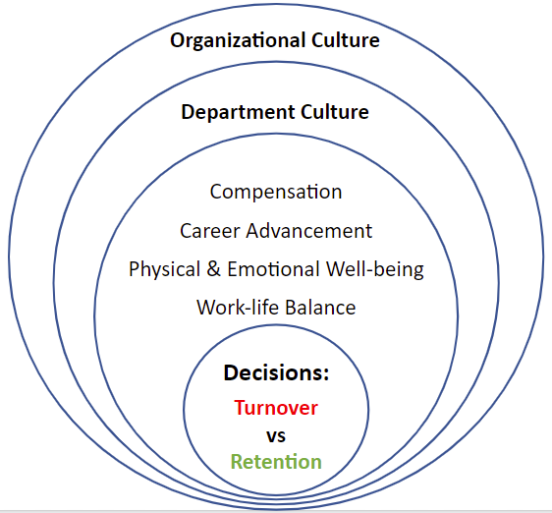
Results of Initial Perioperative Nurse Turnover Study
Perioperative Nurse Turnover Decision-Making
Theory⁴
The dimensions of perioperative nurse well-being influence decisions to leave an OR position.
Notes:
Perioperative nurse dimensions of wellbeing influence decisions to leave an OR position.
The dimensions of perioperative nurse wellbeing include physical and emotional well-being, career development, work-life balance, organizational and departmental culture, and compensation.
Wellbeing: A combination of positive states of physical and emotional health, and an overall satisfaction with life, social connections and economic status.
In Australia, the AHHA recommends that safeguarding the wellbeing of nursing staff should involve policy initiatives, interventions and ongoing monitoring at departmental and organisational levels¹³ Similarly, WorkSafe Victoria (Australia) suggests that making mental health improvement projects successful involves leaders creating positive workplaces, fostering teamwork and adjusting workplace practices. ⁶²

Slide 8
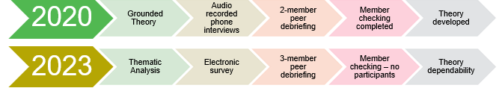
Dependability of the Theory
  Established dependability of the Perioperative Nurse Turnover Decision-Making Theory

Slide 9
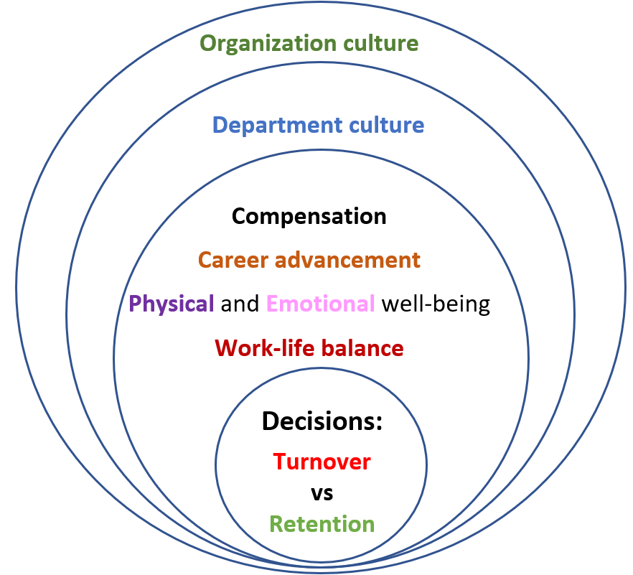
Factors Influencing Decision to Leave^{2,3,5}
Wanted incentives
Work-life Balance
Exhausted
Health Issues
Physical Demands of Job
Family Reasons
Hours
Work Environment/ Culture
Burnout / Emotional Exhaustion
Supervisor/Manager
Salary
Tired of the Career
Staffing challenges/contract labor
Stressed
Career Advancement
Trapped
Retirement
Employer
Not able to Deliver Quality Care
Commute
Lack of support from leaders
Not feeling heard
New Nurses Learning by Fire
Education

Slide 10


What can You Do:
As a leader?
As a staff member?
Break into groups
Take 5 minutes to discuss the scenarios provided
Reconvene as a group and share your plans

Slide 11
Monthly town hall meetings to speak with leadership
Proposed Retention Activities^{3,5-8}
1:1 meetings with staff
Schedule Flexibility
Daily staff rounding
Establish Call Teams
Recognition
Counseling and Therapy Services
Tuition Reimbursement
Workplace Sense of Belonging
Recruitment & Retention Bonuses
Structural empowerment
EAP
Organizational Level Focus
Supervision and Mentorship Programs
Staff Level Focus
Eliminate call
Management Training
Training in mindfulness
Staff celebrations
Manageable workloads
Training in assertiveness
Reverse mentorships
Adequate support
Training in procedures
AORN membership
Tiered System for Pay
Training on technologies
Policies & Procedures
Notes:
Structural empowerment: the extent to which perioperative nurses feel they have access to opportunities for professional growth, resources, information, and sup-port in their work setting
Workplace sense of belonging: the extent to which a perioperative nurse feels personally accepted, respected, included, and supported by others in the organizational environment
Tiered system for pay (scrub & circ paid more, but those who can do both in all services, paid the most)
Every RN hired saves $79,100. An NSI contract to replace 20 travel nurses could save your institution $1,582,000 (NSI, 2025)
RN turnover has been decreasing from 27.1 to 16.4 from 2021 to 2025 (NSI, 2025)
To better understand how hospitals met their RN staffing needs, respondents were asked to identify strategies utilized when faced with a nursing shortage. The top five most common strategies to staff the bedside include: asking RNs to volunteer for overtime, authorizing critical staffing pay, flexing part-time or per diem employees, relying on travel/agency nurses and utilizing the internal staffing pool. Other strategies include enhancing recruitment incentives, hiring more ancillary staff, modifying the nursing care model, mandating overtime, and mandating staff to float. The vast majority of hospitals (80.9%) have a strategy to protect newly hired RNs, many of which include a Nurse Residency Program. fifty-four percent (54.2%) of hospitals have developed a strategy to retain this group. According to the NCHWA Nursing Workforce dashboard, approximately thirty-four (34%) of RNs are Baby Boomers. All of whom will reach retirement age by 2030. Hospitals are encouraged to consider a strategy that will protect this knowledge loss. The RN vacancy rate continues to be elevated and currently stands at 9.6%, which equates to hospitals having forty-seven (47) RN vacancies on average. RN demand increases, as nurses move away from the bedside, and as Baby Boomers reach retirement, expect the vacancy rate to remain critical. hospitals bridge the gap by authorizing overtime and crisis pay, by increasing travel staff usage, and by flexing their internal staffing pool. All of which are costly strategies, especially when nurse travel rates average $94/hr and range to $160/hr. Last year, eighty percent (80%) of hospitals anticipated decreasing RN travelers, yet it remained the most common strategy mentioned when faced with a staffing shortage and meeting patient needs. Registered Nurses recorded a similar mean tenure at 5.95 years and ranging to 16.7 years. consistent with previous surveys, a majority (61.4%) of the exited employees had less than two years of service, while employees with more than 5 years of tenure experienced a greater level of organizational commitment. RNs: Over twenty-two percent (22.3%) of all newly hired RNs left within a year, with first year turnover accounting for a third (31.9%) of all RN separations. The median and mode were recorded at 31.1% and 33.3%, respectively.

Slide 12

Let’s Take Another Moment

Slide 13

I love what I do but . . .

Slide 14










Notes:
Compensation: includes wages and benefits, such as vacation & sick time, tuition reimbursement, and a retirement package
Nurses conveyed that they wanted to feel fairly compensated for the workload they carried
1 nurse said “if I'm going to get abused I might as well get paid better for it” and she started traveling

Slide 15
Fauget
Medical Presentation
Thank
You
Contact information: cgkgmayes@gmail.com

Slide 16
References
2025 NSI national health care retention & RN staffing report. (2025). NSI Nursing Solutions, Inc. https://nsinursingsolutions.com/Library.php
Bacon, D. R., & Stewart, K. A. (2024). Results of the 2024 AORN salary and compensation survey. AORN Journal, 120(6), 337–353. https://doi.org/10.1002/aorn.14250
Sadler, D. (2016, April 10). Cover Story: Bullying in the Workplace. OR Today. https://ortoday.com/cover-story-bullying-in-the-workplace/
Mayes, C. G., & Cochran, K. (2023). Factors influencing perioperative nurse turnover: A Classic Grounded Theory study. AORN Journal, 117(3), 161–174. https://doi.org/10.1002/aorn.13880
Kesten, K. S., Cox, C. W., LeGrand, E. K., & Pearl Zhou, Q. (2025). Factors Associated With Turnover Among Perioperative Nurses After the COVID-19 Pandemic. AORN Journal, 122(1), 20–32. https://doi.org/10.1002/aorn.14368
Dwyer, P., Engstrand, S., & Dyer, A. (2025). The influence of workplace sense of belonging and structural empowerment on perioperative nurses’ turnover intent. AORN Journal, 121(4), 267–279. https://doi.org/10.1002/aorn.14317
Xie, A., Xu, H. (Grace), & Duff, J. (2025). Factors influencing perioperative nurses’ retention and turnover decisions: A qualitative analysis. Perioperative Care and Operating Room Management, 40, 100503. https://doi.org/10.1016/j.pcorm.2025.100503
Xie, A., Duff, J., & Munday, J. (2024). Perioperative nursing shortages: An integrative review of their impact, causal factors, and mitigation strategies. Journal of Nursing Management, 2024(1), 2983251. https://doi.org/10.1155/2024/2983251

