Slide 1
Body Mechanics to Reduce Physical Stress
Glen Foreman PT, DPT, LAT, ATC, CLT, CES
Alex Papanastassiou PT, DPT
Leah Goldberg MSN, RN, CNOR

Slide 2
Disclaimer
This presentation is intended for educational and informational purposes only. The content shared reflects general best practices, current evidence, and professional insights. It is not designed to provide individual health assessments, diagnoses, or personalized medical advice. Attendees are encouraged to consult with qualified healthcare professionals for specific concerns. Participation in this session does not establish a provider-patient relationship.

Slide 3
Objectives
Discuss common workplace injuries for perioperative staff.
Describe the importance of core strength and mobility in body mechanics.
Demonstrate changes to body mechanics during common tasks for perioperative staff to minimize physical strain.

Slide 4
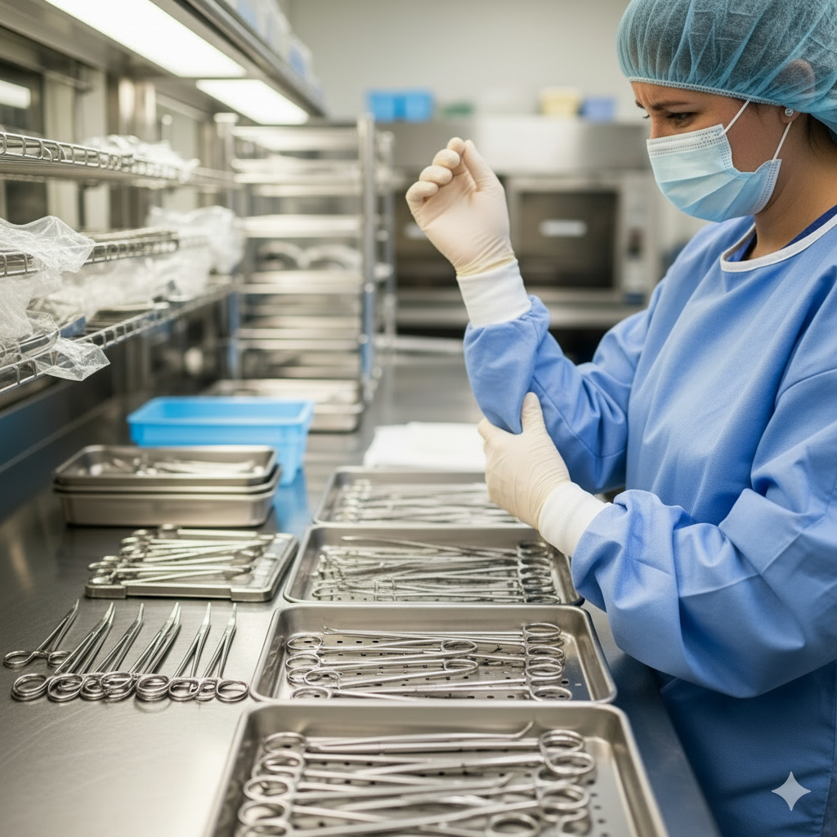


Sound Familiar?

Slide 5
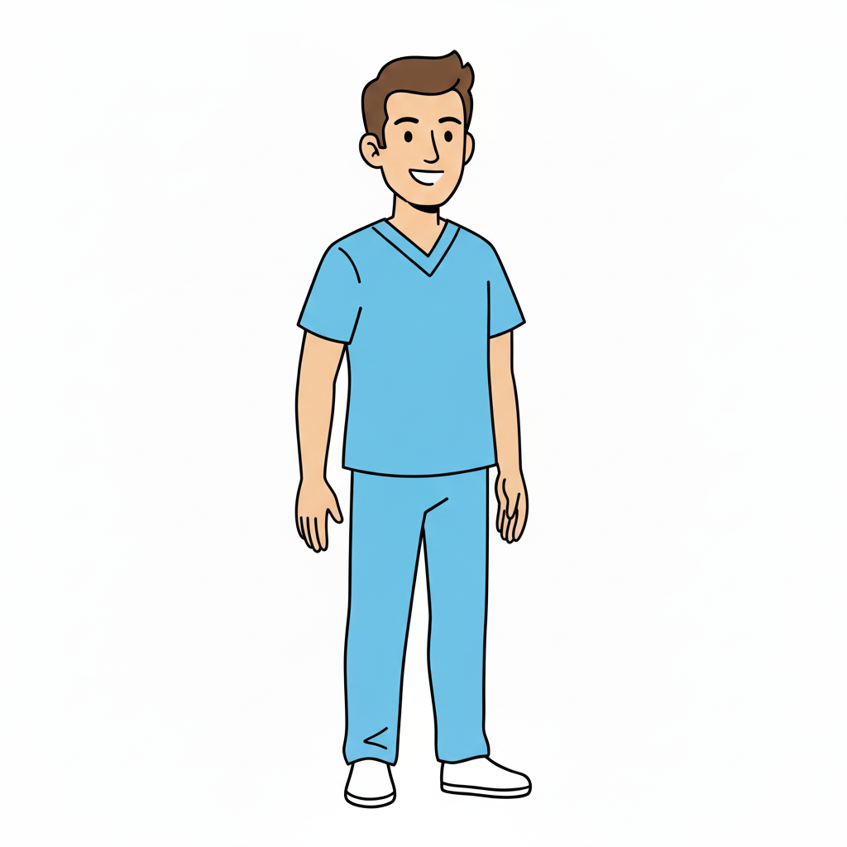
Healthcare Worker Injury
500,000 incidents of job related injury/illness in 2023
Higher incidence recorded among perioperative staff
Second most common - Musculoskeletal Injuries
Back
Shoulder
Knee

Slide 6
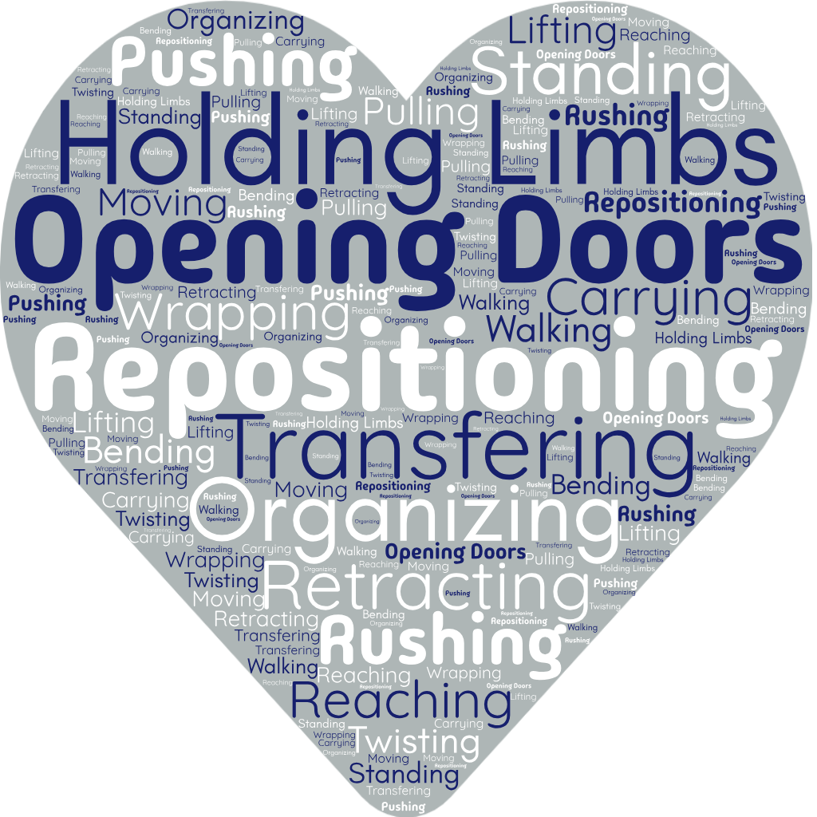
Common Causes

Slide 7
Consequences
Individual
Department
Workplace injuries among healthcare workers cost $13.1 billion and accounted for 2 million lost work days
Pain
Lost income
Treatments
Surgery
Missed work days
Missed life events
Stress
Early career exit
Decrease morale
Decrease staff satisfaction
Decrease retention
Increase team stress
Increase team risk of injury
Costly
Workplace Injury

Slide 8
What Can You Do About It?
Proactive Approach
Culture of Safety
Equipment and Devices
Guidelines
You can control your Body Mechanics

Slide 9
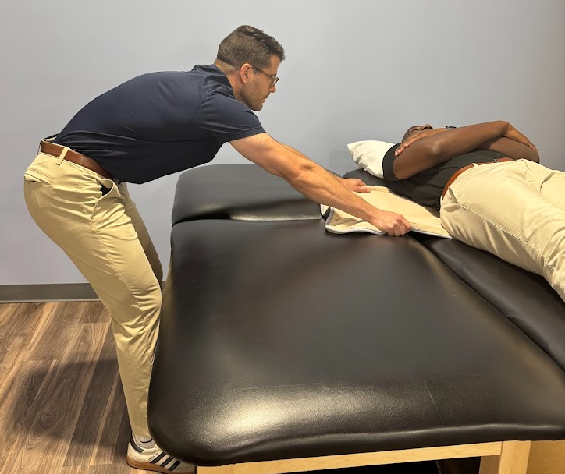
Intro to Body Mechanics

Slide 10
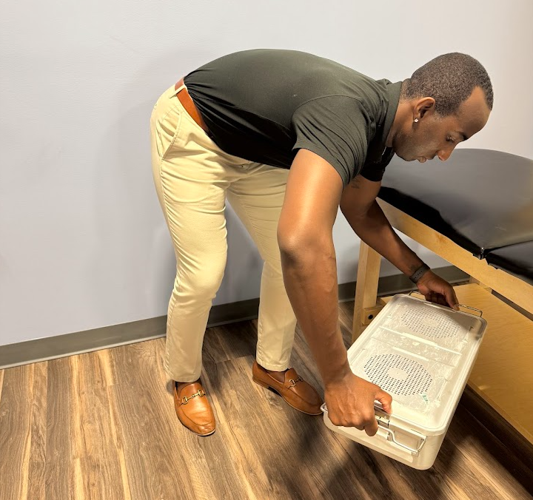
Objectives
Identify common challenges in the OR
Describe positioning for reducing injury
Apply the rules to the specific OR tasks
Provide simple takeaway exercises

Slide 11
Common Challenges
Pushing and Pulling
Transferring a patient on a table
Pushing a cart
Moving an OR table
Lifting
Holding a patient’s limbs
Maneuvering trays
Carrying equipment
Notes:
Holding the patient’s limb for surgical prep

Slide 12
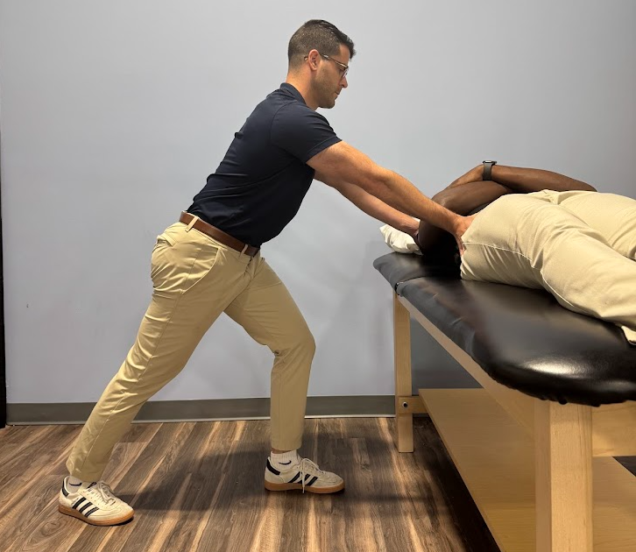
Rules of Biomechanics
Neutral pelvis
Long spine
Stabilize trunk
Use arms without compensation
Flexibility is critical
Notes:
Good posture and good movement is dynamic. The ability to get into “neutral” starting positions indicates a reduction in injury risk, but the goal is to be as dynamic as possible in the positions you can get into. As load increases, dynamic flexibility is less important and the goal shifts towards bracing your trunk to reduce injury
Low load --> goal is dynamic flexibility
High load --> goal is trunk stability

Slide 13
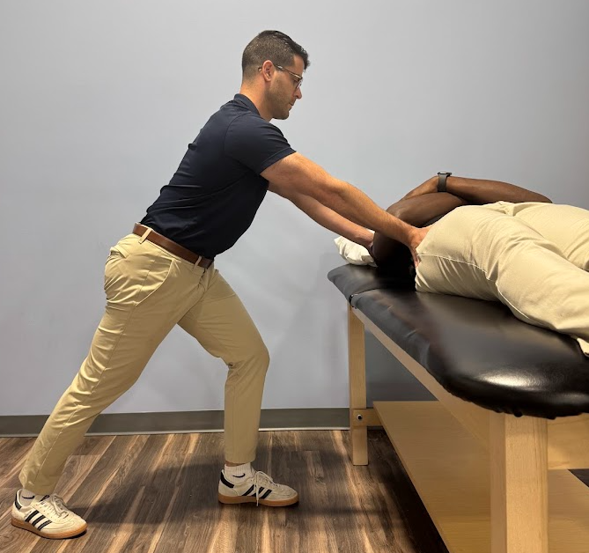
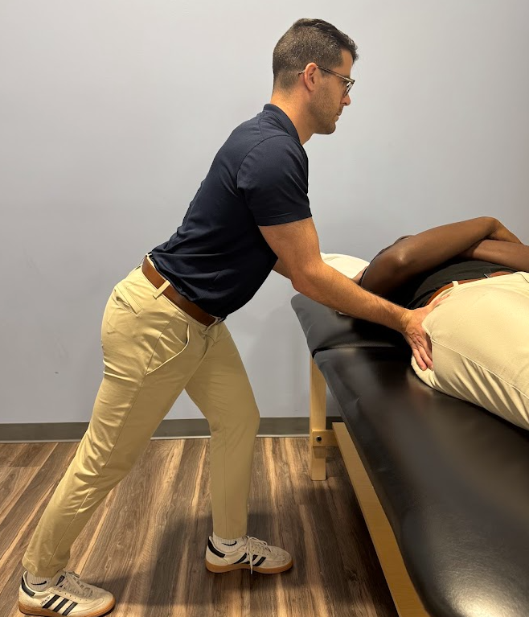
Rules of Biomechanics
Neutral pelvis
Notes:
Ideal pelvic position helps you to stabilize your spine and take pressure off your back. It can be a little different for each person

Slide 14
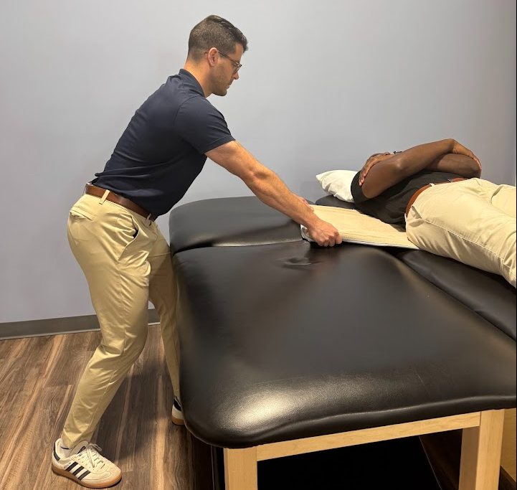
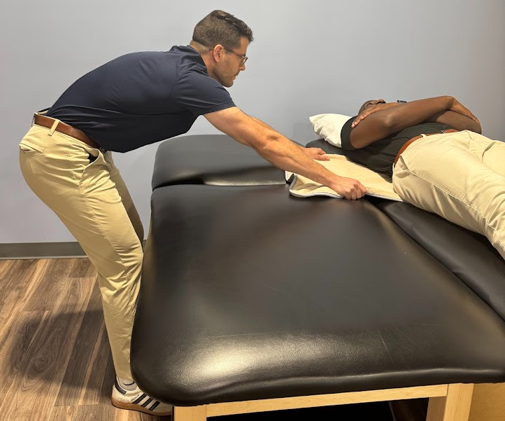
Rules of Biomechanics
2. Long spine
Notes:
Ideal spine maintains some curves but is generally in a straight position

Slide 15
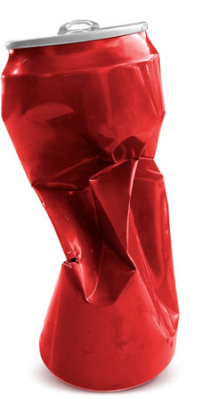

Rules of Biomechanics
3. Stabilize trunk
Notes:
Stabilizing your trunk is a necessary skill to ensure both your spine is in a good position as well as your arms when you do tasks. The OR involves routine tasks that can carry substantial load. Stabilizing the trunk creates a stable platform

Slide 16
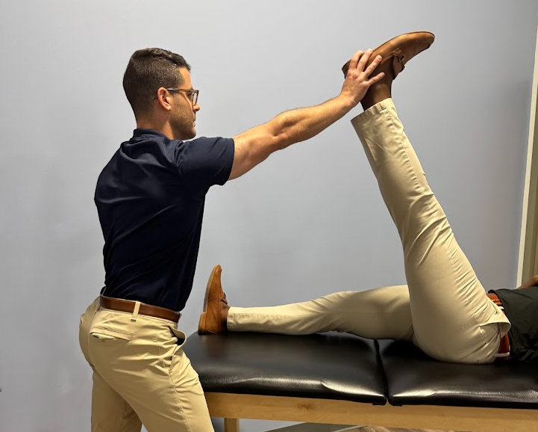
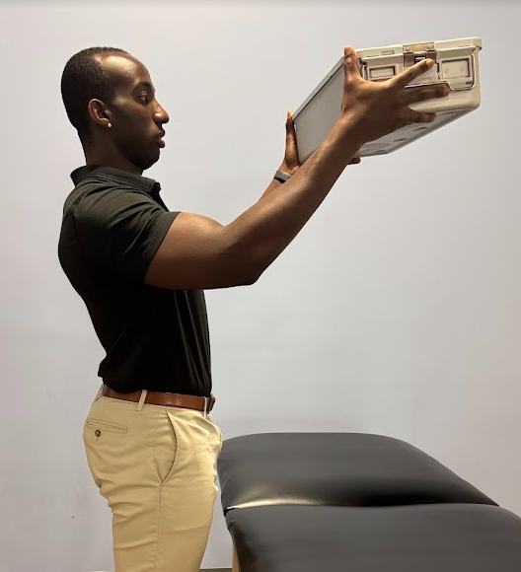
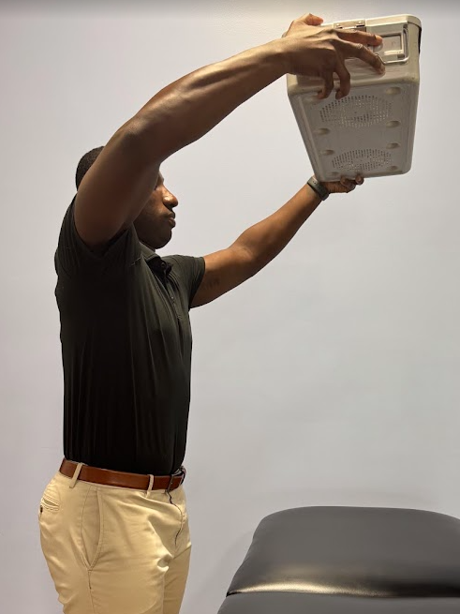
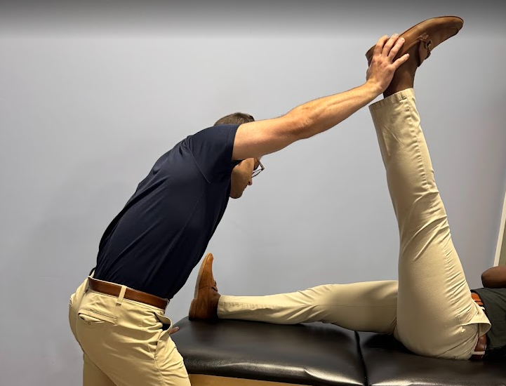
Rules of Biomechanics
4. Use arms without compensation
Notes:
Almost everything you do involves use of your arms. Understanding compensations allows you to take stress off distal joints

Slide 17
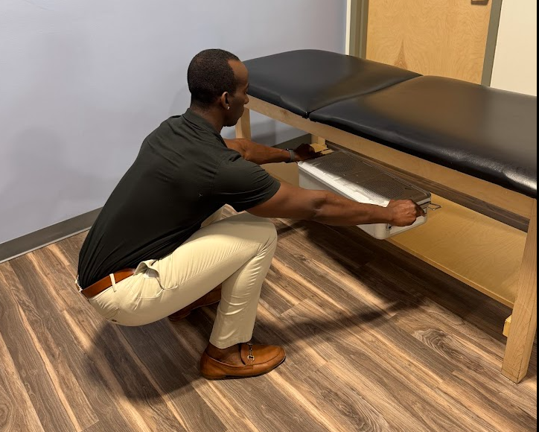
Rules of Biomechanics
Neutral pelvis
Long spine
Stabilize trunk
Use arms without compensation
Flexibility is critical
Notes:
Two parts.
Part one: Increasing base of support of your legs. Widening stance, turning toes out, or entering a split stance leg position.
Part two: improving range of motion through shoulders and spine allows you to position your upper half with less stress during repetitive tasks.

Slide 18
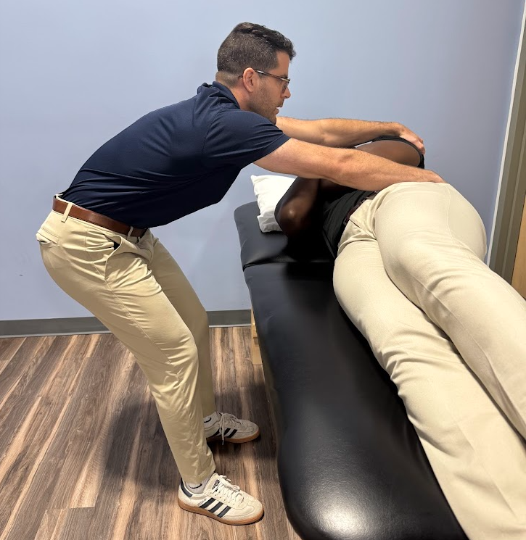
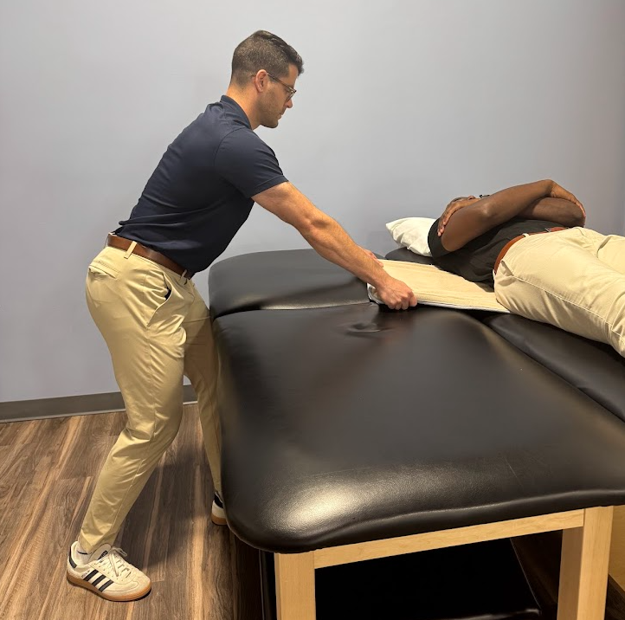
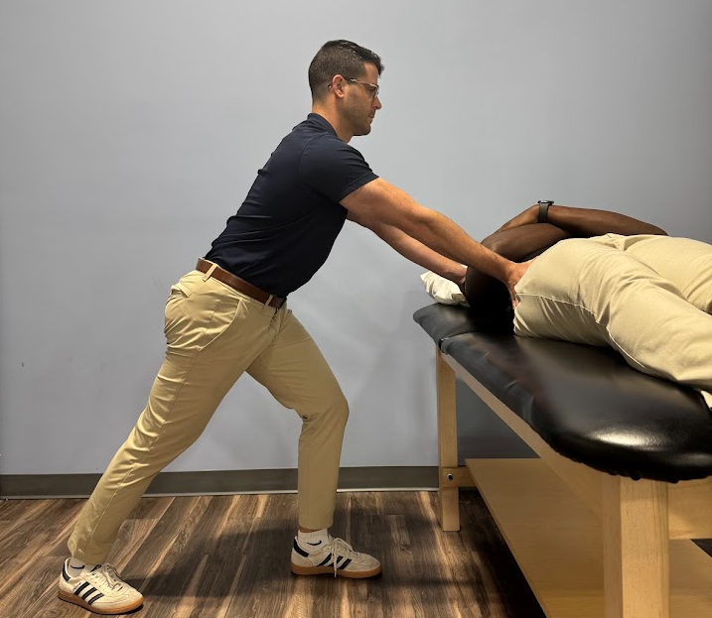
Task 1: Pushing and Pulling
Notes:
**Explain how to set yourself into position using the RULES**
BIOMECHANICS ANALYSIS
Position legs in split stance rather than side by side
Rear leg is in position to create a force vector forward, in line with the direction you may be moving the patient
Provides access to ankle dorsiflexion/plantarflexion as well as hip flexion/extension. This allows the weight shift necessary to move a patient to occur through “safe” joints rather than at the lumbar spine
Legs side by side puts both ankles and hips in position where forward/backward translation are BLOCKED --> increases motion demands through lumbar spine
Patient is heavy - need to brace trunk accordingly to buttress the load
Push/pull through arms without compromising neck position
CAVEAT - legs side to side (with toes pointed out slightly) is better for moving the patient laterally on table, as it opens space at the hip joint to allow a lateral pelvic movement to direct patient
This applies to any task where you are pushing and pulling

Slide 19
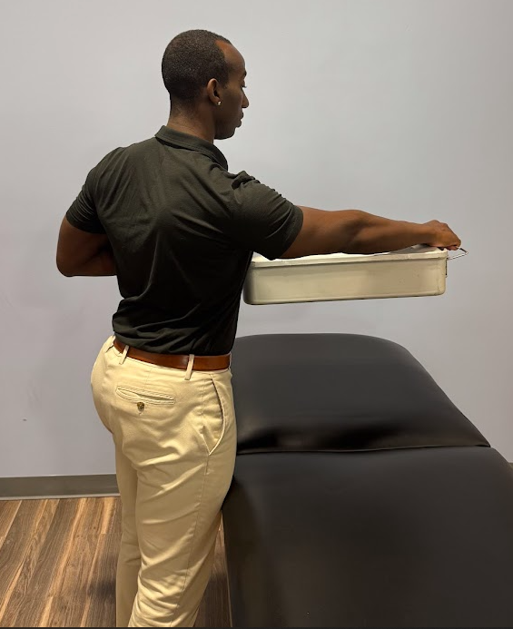
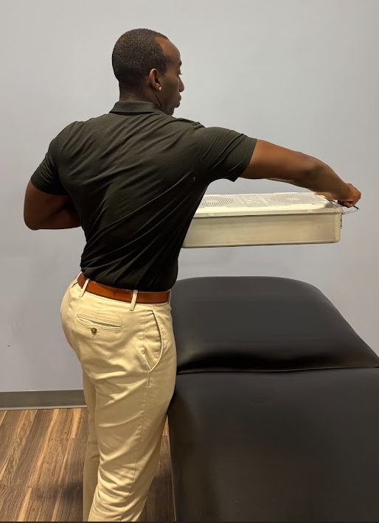
Task 2: Lifting, Reaching, Carrying
Notes:
**Explain how to set yourself into position using the RULES**
Using arms involves combination of 1) very low load, repetitive tasks and 2) higher load lifting and moving
BIOMECHANICS ANALYSIS OF LIFTING and MOVING
Really important here is understanding the compensations
Shoulder shrugging/dumping out of position - creates loss of stability at scapula and glenohumeral joint, exposing joints at wrist, elbow, shoulder, neck to aberrant and excessive force
Elbows flaring outward - this is a weaker position that indicates loss of stability at shoulder. Exposes supraspinatus to challenging rotational position, and increases force demands at elbow and wrist which leads to chronic strain
Excessive neck involvement - the neck and head will lose position in order to help lift. This compromised position can cause long term stress
Widen base of support when moving something from point A to point B
You never want to place something outside of where your feet are
Within BOS (hands within feet), your pelvis and legs can shift position, reducing spine load
Outside BOS (hands past feet) necessitates rotation/sidebending through the spine which greatly increases annular, facet, and disc stress at the lumbar and cervical vertebrae
Increasing range of motion through thoracic spine and shoulders allows greater ability to put your hands where you need them to go without compromising positions
BIOMECHANICS ANALYSIS OF LOW LOAD, REPETITIVE TASKS
Much greater emphasis on positioning and mobility
Positioning - set your base up to allow weight shift through shoulders and pelvis. This maintains integrity of distal joints (elbows, wrists) and can reduce need for uncomfortable neck positions
Mobility - greater mobility of all joints allows better positioning and thus less stress

Slide 20
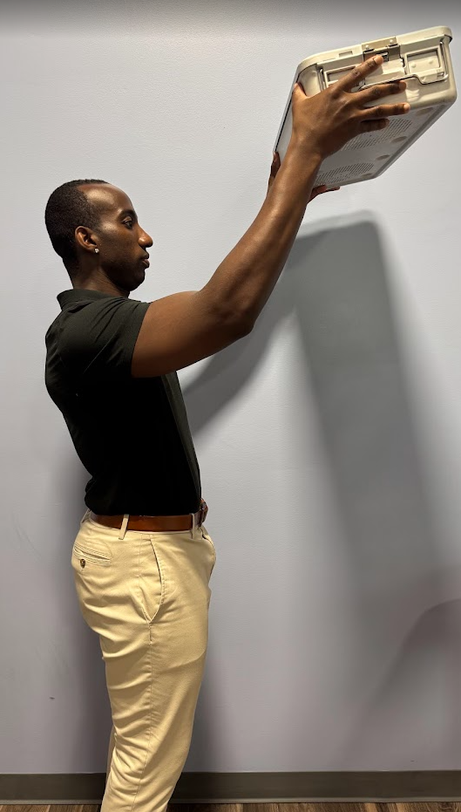
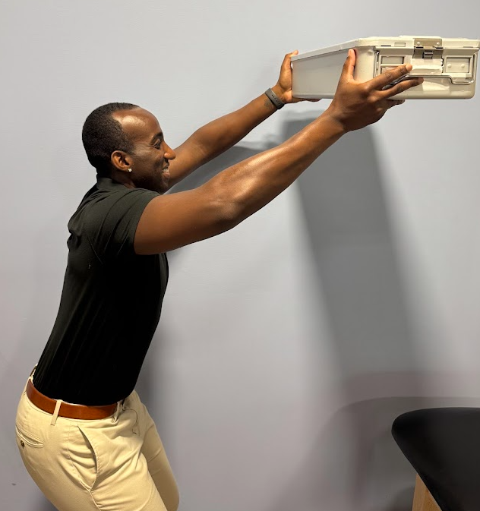
Task 2: Lifting, Reaching, Carrying
Notes:
**Explain how to set yourself into position using the RULES**
Using arms involves combination of 1) very low load, repetitive tasks and 2) higher load lifting and moving
BIOMECHANICS ANALYSIS OF LIFTING and MOVING
Really important here is understanding the compensations
Shoulder shrugging/dumping out of position - creates loss of stability at scapula and glenohumeral joint, exposing joints at wrist, elbow, shoulder, neck to aberrant and excessive force
Elbows flaring outward - this is a weaker position that indicates loss of stability at shoulder. Exposes supraspinatus to challenging rotational position, and increases force demands at elbow and wrist which leads to chronic strain
Excessive neck involvement - the neck and head will lose position in order to help lift. This compromised position can cause long term stress
Widen base of support when moving something from point A to point B
You never want to place something outside of where your feet are
Within BOS (hands within feet), your pelvis and legs can shift position, reducing spine load
Outside BOS (hands past feet) necessitates rotation/sidebending through the spine which greatly increases annular, facet, and disc stress at the lumbar and cervical vertebrae
Increasing range of motion through thoracic spine and shoulders allows greater ability to put your hands where you need them to go without compromising positions
BIOMECHANICS ANALYSIS OF LOW LOAD, REPETITIVE TASKS
Much greater emphasis on positioning and mobility
Positioning - set your base up to allow weight shift through shoulders and pelvis. This maintains integrity of distal joints (elbows, wrists) and can reduce need for uncomfortable neck positions
Mobility - greater mobility of all joints allows better positioning and thus less stress

Slide 21
Five Exercises to Get You Started
Rocking Pelvic Tilt at Wall
Weight Shifting
Neck + Shoulder Stabilization
Thoracic Rotation - In Split Stance at Wall
Upper Trap Stretch

Slide 22
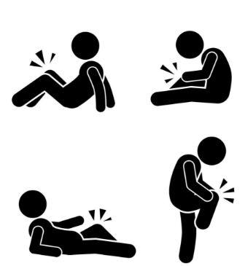
Available Resources
PT evaluation - without MD order in some states
Don’t ignore pain - seek help from medical provider
Occupational Health Department

Slide 23
Conclusion
Take a
Look
Small changes make big impacts
These changes can be implemented immediately
Improve your resiliency through practice
Education, education, education
Let’s GO!
Top
Priority
Work in progress

Slide 24
Thank You!
Contact Us
Glen.Foreman@ivyrehab.com
Alexander.Papanastassiou@ivyrehab.com
Notes:
THANK YOU!
Can we answer any questions?

Slide 25
References
Apple, B., & Letvak, S. (2021). Ergonomic challenges in the perioperative setting. AORN Journal, 113(4), 339-348. https://doi.org/10.1002/aorn.13345
Fencl, J.L. (2021). Prioritizing staff safety. AORN Journal, 113(4), 326-327. https://doi.org/10.1002/aorn.13360
Fencl, J.L., Willoughby, C. & Jackson, K. (2021). Just culture: The foundation of staff safety in the perioperative environment. AORN Journal, 113(4), 329-336. https://doi.org/10.1002/aorn.13352
Garbarino, C. (2022). The importance of ergonomic education in preventing perioperative musculoskeletal disorders. AORN Journal, 115(4), 364-370. https://doi.org/10.1002/aorn.13653
Karayan, E. (2024). Mitigating hazards in the perioperative setting. AORN Journal, 120(6), 382-386. https://doi.org/10.1002/aorn.14259
Letvak, S., Apple, B., & Jenkins, M. (2024), Factors affecting perioperative nurse adherence to ergonomic safety measures. AORN Journal, 119(3), 210-221. https://doi.org/10.1002/aorn.14097
Pure Processing. (2024, August 27). Understanding ergonomic injuries in the sterile processing department: A critical issue in healthcare. https://pure-processing.com/blog/understanding-ergonomic-injuries-in-the-sterile-processing-department-a-critical-issue-in-healthcare/#:~:text=The%20most%20common%20injuries%20seen,strains%2C%20and%20carpal%20tunnel%20syndrome
Ravinal, L., O’Donnell, S., & Barth, E. (2020). An ergonomic surgical instrument initiative to foster a healthy work environment. AORN Journal, 112(5), 554-554. https://doi.org/10.1002/aorn.13223
Simon, R.W., DiTullio, B.L., Foster, L.A., Canacari, E.G., & Guglielmi, C.L. (2016). Eliminating workplace hazards in the OR. Perioperative Care and Operating Room Management, 2,18-27. https://doi. org/ 10.1016/j. pcorm. 2016. 01. 0042.
Spruce, L. (2020). Preventing staff member injury through safe patient handling and movement. AORN Journal, 111(5), 567-568. https://doi.org/10.1002/aorn.13023
US Bureau of Labor Statistics. (2024, December 3). Health care and social assistance had 562,500 injuries and illnesses in 2023, fewer than in 2022. https://www.bls.gov/opub/ted/2024/health-care-and-social-assistance-had-562500-injuries-and-illnesses-in-2023-fewer-than-in-2022.htm
US Bureau of Labor Statistics. (2022, February 11). Registered nurses, 2016-2020. https://www.bls.gov/iif/snapshots/osn-registered-nurses-2016-20.htm

